Slide 1




Population genetics and data analysis in R programming language
Dr. Shankar Kaji Shakya
https://shankarkshakya.github.io/
Botany and Plant Pathology
Oregon State University, USA

Slide 2
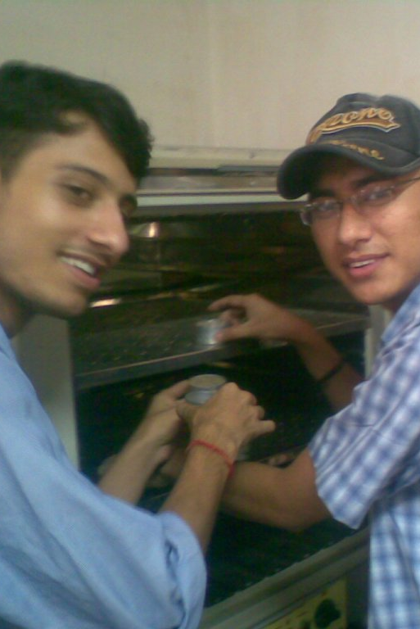
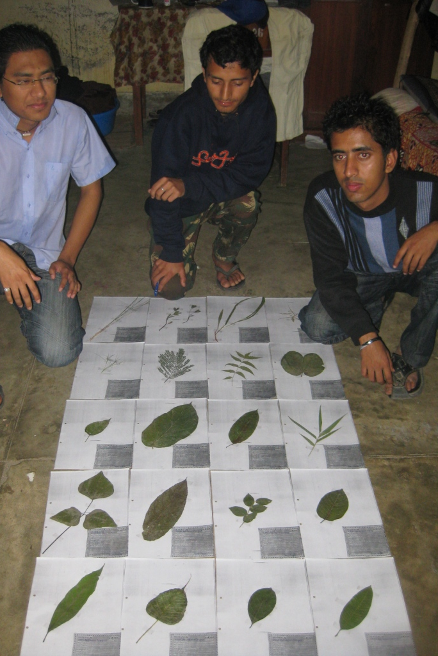
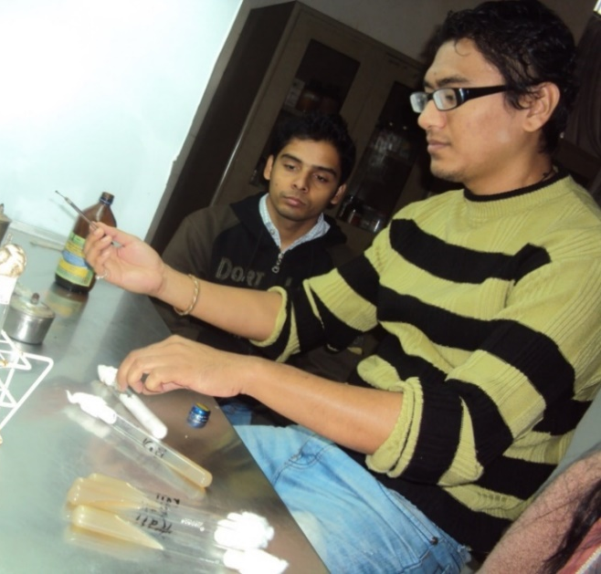
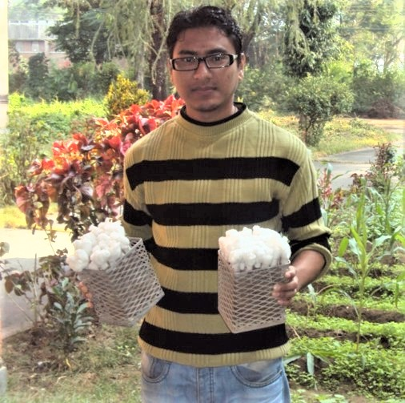
B.S. Plant Pathology
Tribhuwan University, Nepal (2006-2010)

Slide 3

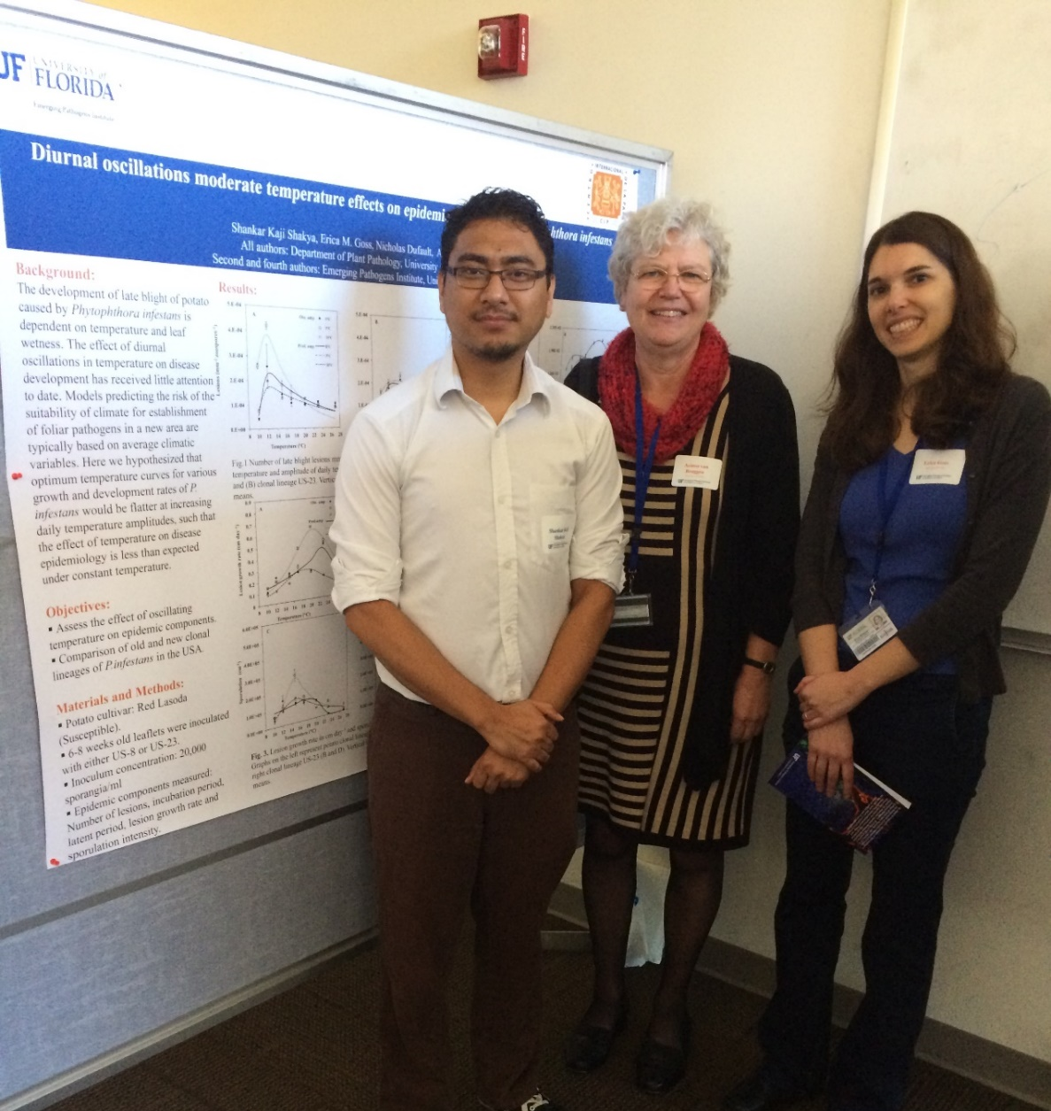
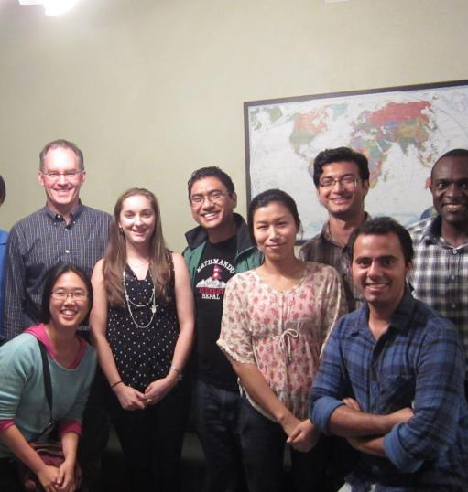
M.S. Plant Pathology
University of Florida (2012-2014)

Slide 4
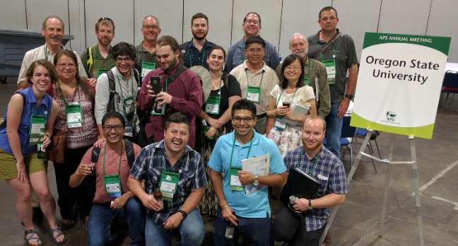
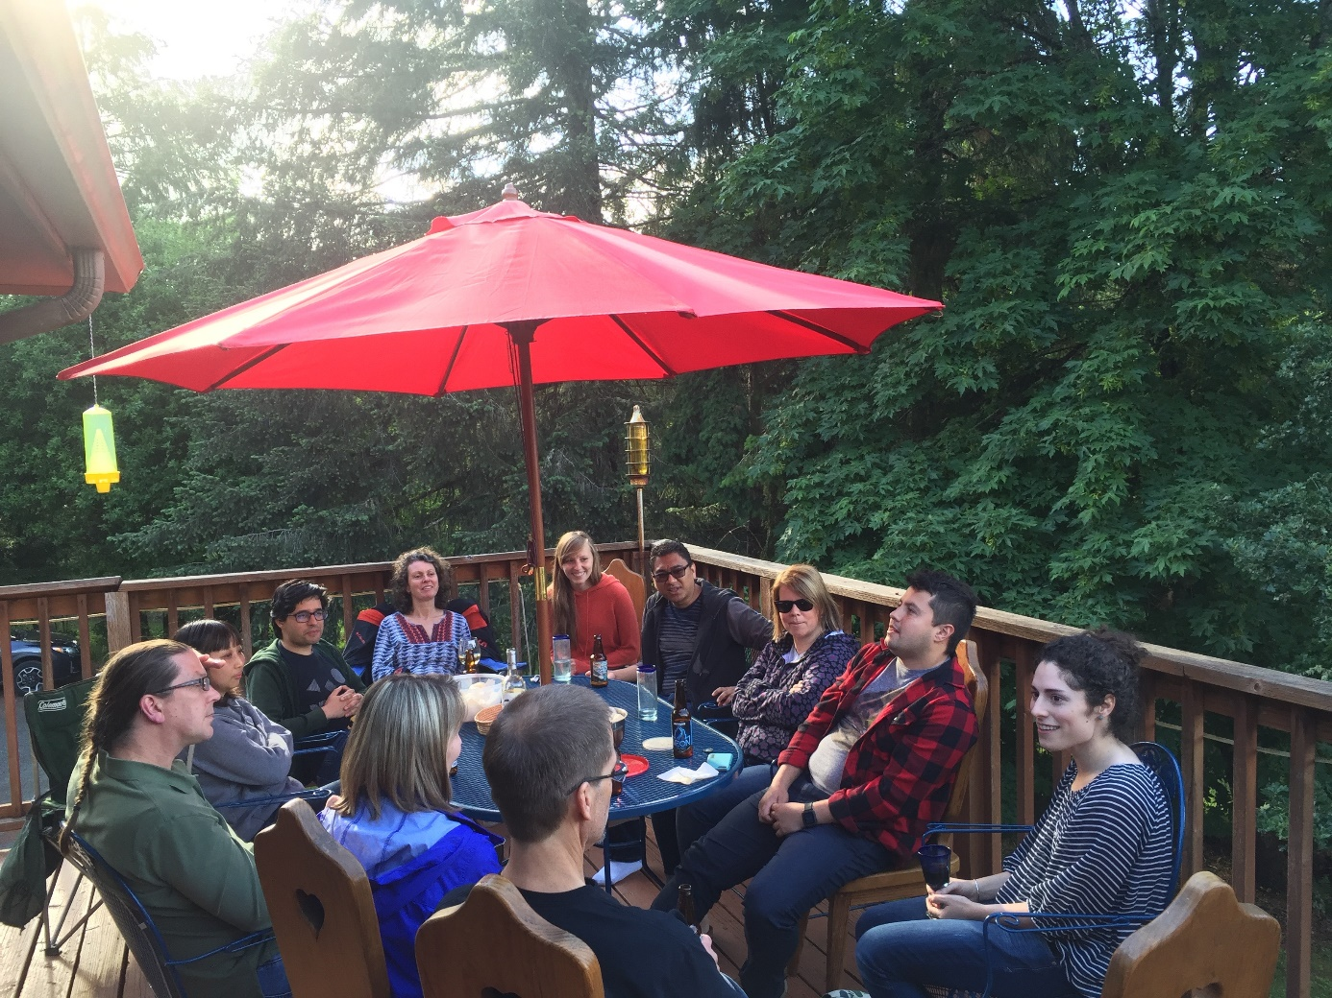
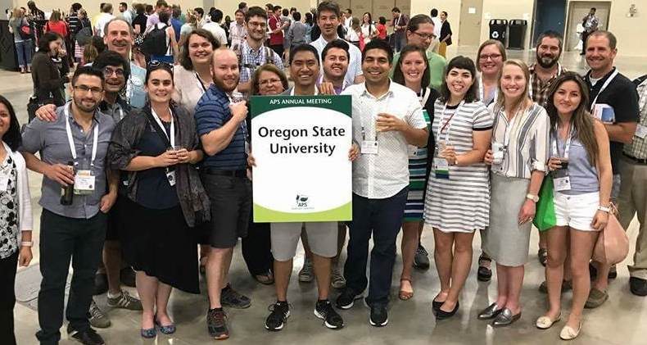
Ph.D.
Oregon State University

Slide 5
Information about workshop
This will be a 2.5-3 day workshop
Each day 10 am - 4 pm with appropriate breaks
We will learn 3 important things in this workshop
What is population genetics?
What is R and R programming?
How to analyze population genetics data in R?
Be respectful

Slide 6
Overall outline:
Day 1: Lecture on introduction to population genetics, Hardy Weinberg equilibrium, microsatellite markers, population structure and clustering, neighbor joining tree.
Day 2: R and Rstudio, data analysis in R and plotting.
Day 3: Microsatellite data analysis in R (Shakya et al. 2018) and certificate distribution

Slide 7
Now lets make a group of 4 people

Slide 8
Day 1 : Intro to population genetics
Study of genetic composition of the population and forces that cause changes in this composition. Simply, it is also the study of forces like mutation, migration, selection and drift. Before diving into details, there are some key concepts that we need to learn.
Locus (plural loci): Position in a genome where one or more alleles are segregating.
ATGC………………………………………………………….
From nucleotide to genome

Slide 9
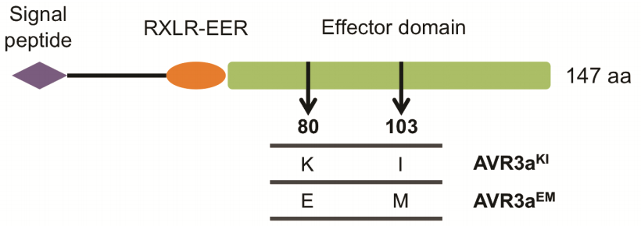
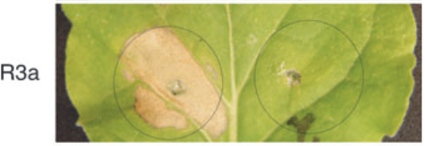
Allele: It is a variant form of a gene
Avr3a^{KI} triggers hypersensitive response but not Avr3a^{EM}
Isoforms of Avr3a
Avr3a^{KI} Avr3a^{EM}
Bos et al. 2006, The Plant Journal

Slide 10
Genotype: Genotype is the combination of the alleles at a particular locus.
If an individual has same allele at a locus, we call that homozyogous individual e.g AA or aa If an individual has different allele at a locus, we call that heterozygous individual e.g Aa
Allele frequency: Frequency of copies of the allele in the population divided by total number of gene copies in the population.
Genotype frequency: Number of individuals of certain genotype divided by total number of individuals.

Slide 11
Problem number 1:
Lets look at a locus that carries two alleles, A and B. In diploids, we would observed three possible genotypes, two homozygous (AA and BB), and one heterozygous (AB).
Lets say we found following genotype count,
AA=38, AB=16, BB = 46.
Calculate genotype frequency and allele frequency
Solution
AA genotype freq = AA/total number of individuals
AB genotype freq = AB/total number of individuals
BB genotype freq = BB/total number of individuals

Slide 12
Next we ll calculate allele frequency
Definition: allele freq is frequency of copies of the allele in the population divided by total number of gene copies in the population
A = 2*38 + 16
B = 2*46 + 16
Gene copies = 200
Allele freq A = A/gene copies
Allele freq B = B/gene copies

Slide 13
Add some more problems

Slide 14
Hardy Weinberg equilibrium
https://shankarkshakya.github.io/geppopgen/HWE.html

Slide 15
Break 15 minutes

Slide 16
Population structure and Fst
Random mating is rarely observed in nature.
Individuals that are close together are likely to mate with each other than distantly located individuals.
Because of this non random mating, we ll see population subdivision or also known as population structure.
One of the primary reasons we get population structure is geographic barrier like huge water bodies or high mountains.

Slide 17
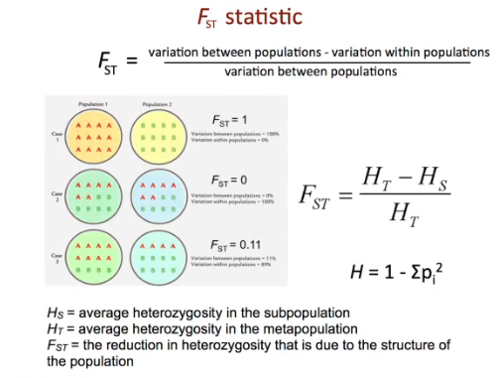

Slide 18
For two populations given below, calculate Fst.
Population 1: AA = 20, Aa = 20, aa = 20
Population 2: AA = 15, Aa = 15, aa = 30
Fst = Ht - Hs / Ht
Hs = heterozygosity in subdivided population
Ht = Expected heterozygosity if the pooled populations is in HWE
Ans: 0.016

Slide 20
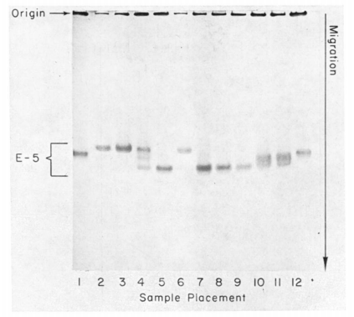
Measure of genetic variation
A molecular approach to the study of genic heterozygosity in natural populations. I. The number of alleles at different loci in Drosophila pseudoobscura.
J. L. Hubby and R. C. Lewontin
Genetics, 1966
Allozyme electrophoresis

Slide 21
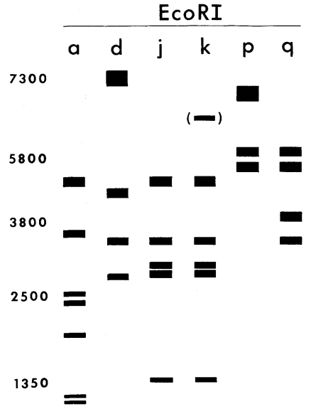
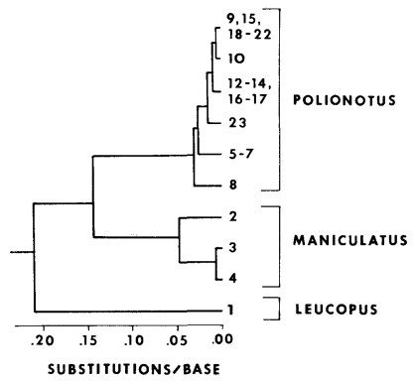
Measure of genetic variation
Restriction enzyme analysis
mt DNA tree
Avise et al. 1979, Genetics

Slide 22
Measure of genetic variation
Microsatellites/SSRs: regions of the genome with repeating sequences of two to six base pairs.
e.g. GTAGTAGTAGTAGTA (tri nucleotide repeat)
Advantage:
Highly polymorphic and easily genotyped.

